Slide 1
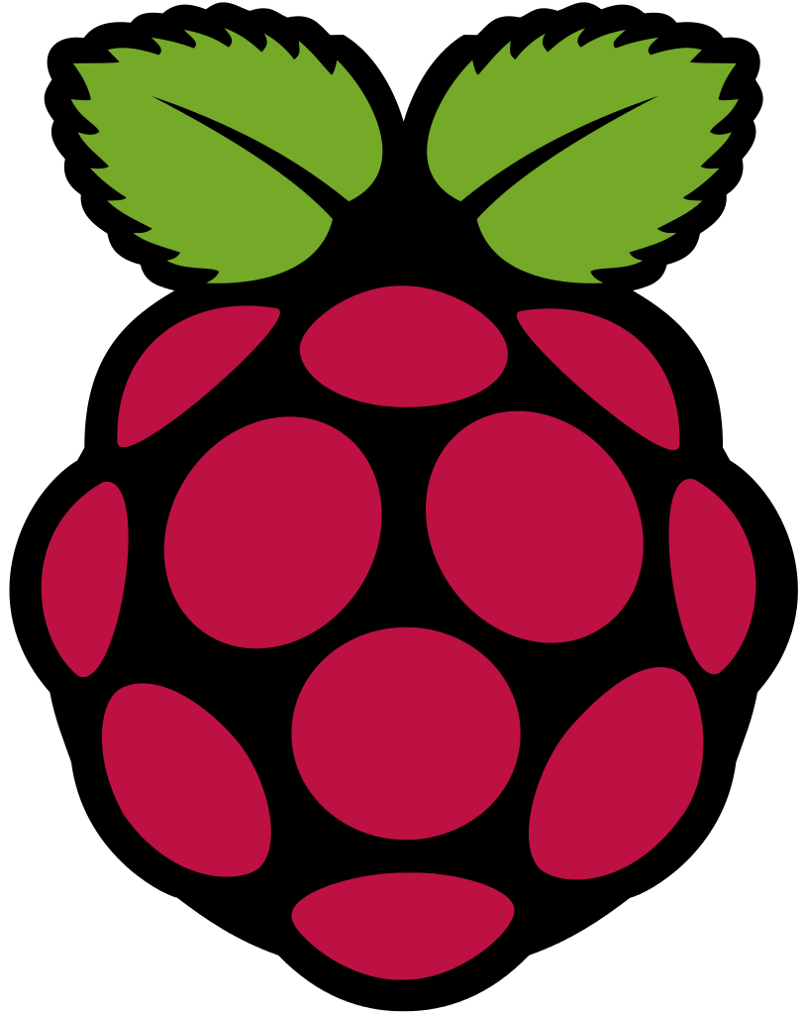

Raspberry Pi 3 - Lecture 1-
H. Melih Erdogan
Lab Assistant
Intelligent Robotics I - ECE 478/578
Electrical and Computer Engineering Department Maseeh
College of Engineering and Computer Science

Slide 2
Lecture Description
The goal of this lecture series is to equip students with the software, hardware, and basic programming skills required to program Raspberry Pi. We will use Raspberry Pi 3 and Linux OS that is specifically designed for Raspberry Pi. Students will also learn about the fundamentals of electronics and variety of different electronic components and devices that are widely used in robotics projects such as sensors, servo motors, dc motors, displays, LEDs etc. The lectures are designed as project-oriented, so students can have hands-on experiences based on the material thought in the lectures.

Slide 3
Who has any experience with Raspberry Pi?

Slide 4
Raspberry Pi 3
Lecture 1: Course Overview
Raspberry Pi Basics
What is Raspberry Pi?
Raspberry Pi Specs?
A little history of Raspberry Pi - What happened?, What is happening?
What is on the board?
Arduino vs Raspberry Pi
Things that you can do with a Raspberry Pi
What you will need
First look – Quick demo
How to set up your Raspberry Pi?
Next week

Slide 5
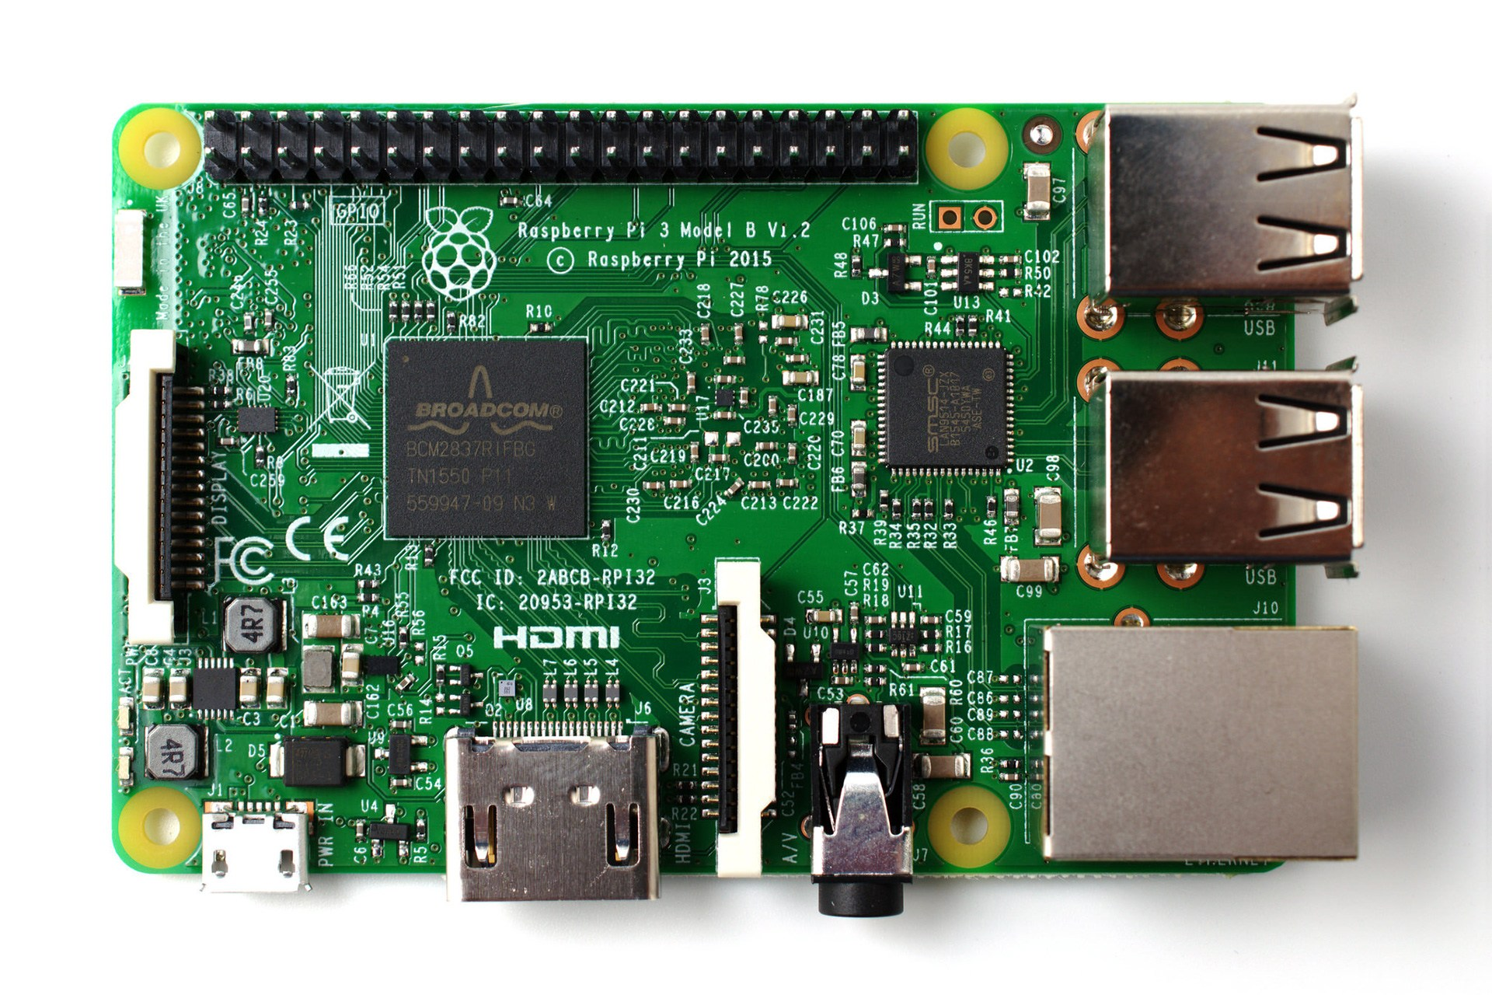
What is Raspberry Pi?
The Raspberry Pi is a credit card-sized computer that plugs into your TV and a keyboard. It is a capable little computer which can be used in electronics projects, and for many of the things that your desktop PC does, like spreadsheets, word processing, browsing the internet, and playing games. It also plays high-definition video. (www.raspberrypi.org)

Slide 6
Where can I buy one?
You can get your Raspberry Pi board online on their website, or any other shopping websites such as Amazon, eBay, Adafruit, and Element14.
You can also buy Raspberry Pi kits that comes with all the necessary things you need to use a raspberry Pi such as micro SD card, USB charger, and HDMI cable. Some kits include other electronics such as LEDs, buttons, switches, cables etc. to build simple electronic circuits.

Slide 7
What is the Raspberry Pi Foundation?
The Raspberry Pi Foundation works to put the power of digital making into the hands of people all over the world, so they are capable of understanding and shaping our increasingly digital world, able to solve the problems that matter to them, and equipped for the jobs of the future.
We provide low-cost, high-performance computers that people use to learn, solve problems and have fun. We provide outreach and education to help more people access computing and digital making. We develop free resources to help people learn about computing and how to make things with computers, and train educators who can guide other people to learn.
https://www.raspberrypi.org/about/

Slide 8
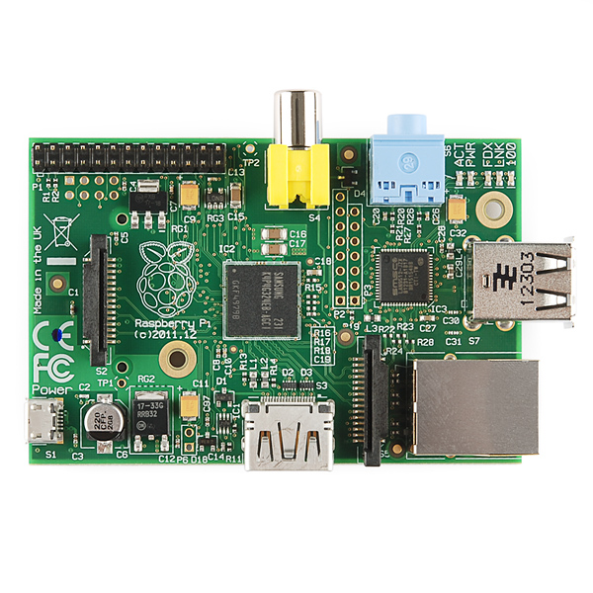
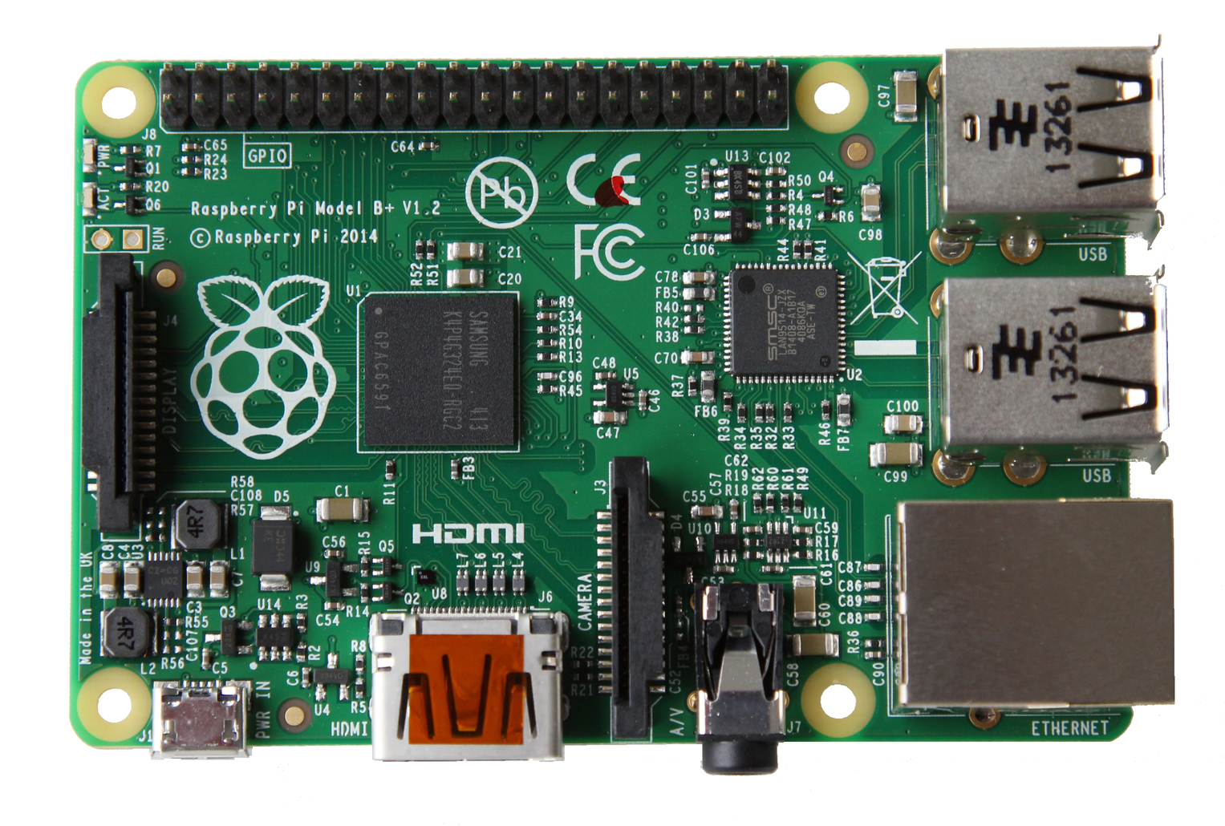
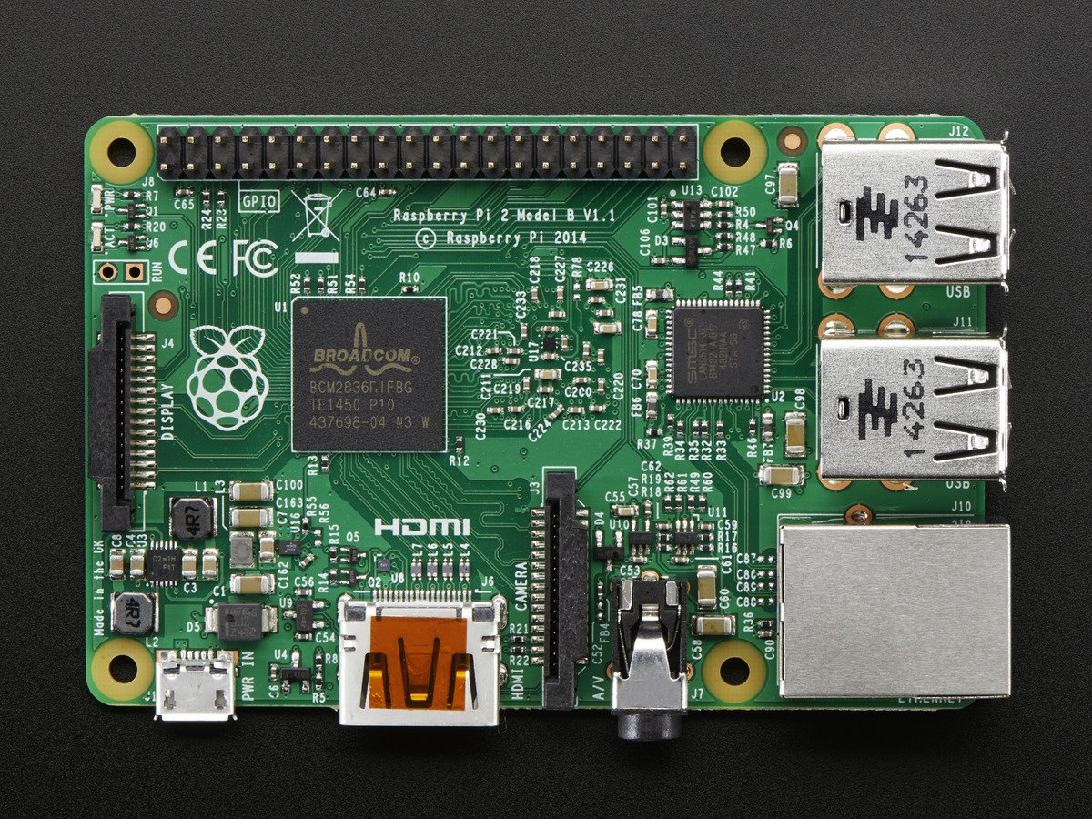
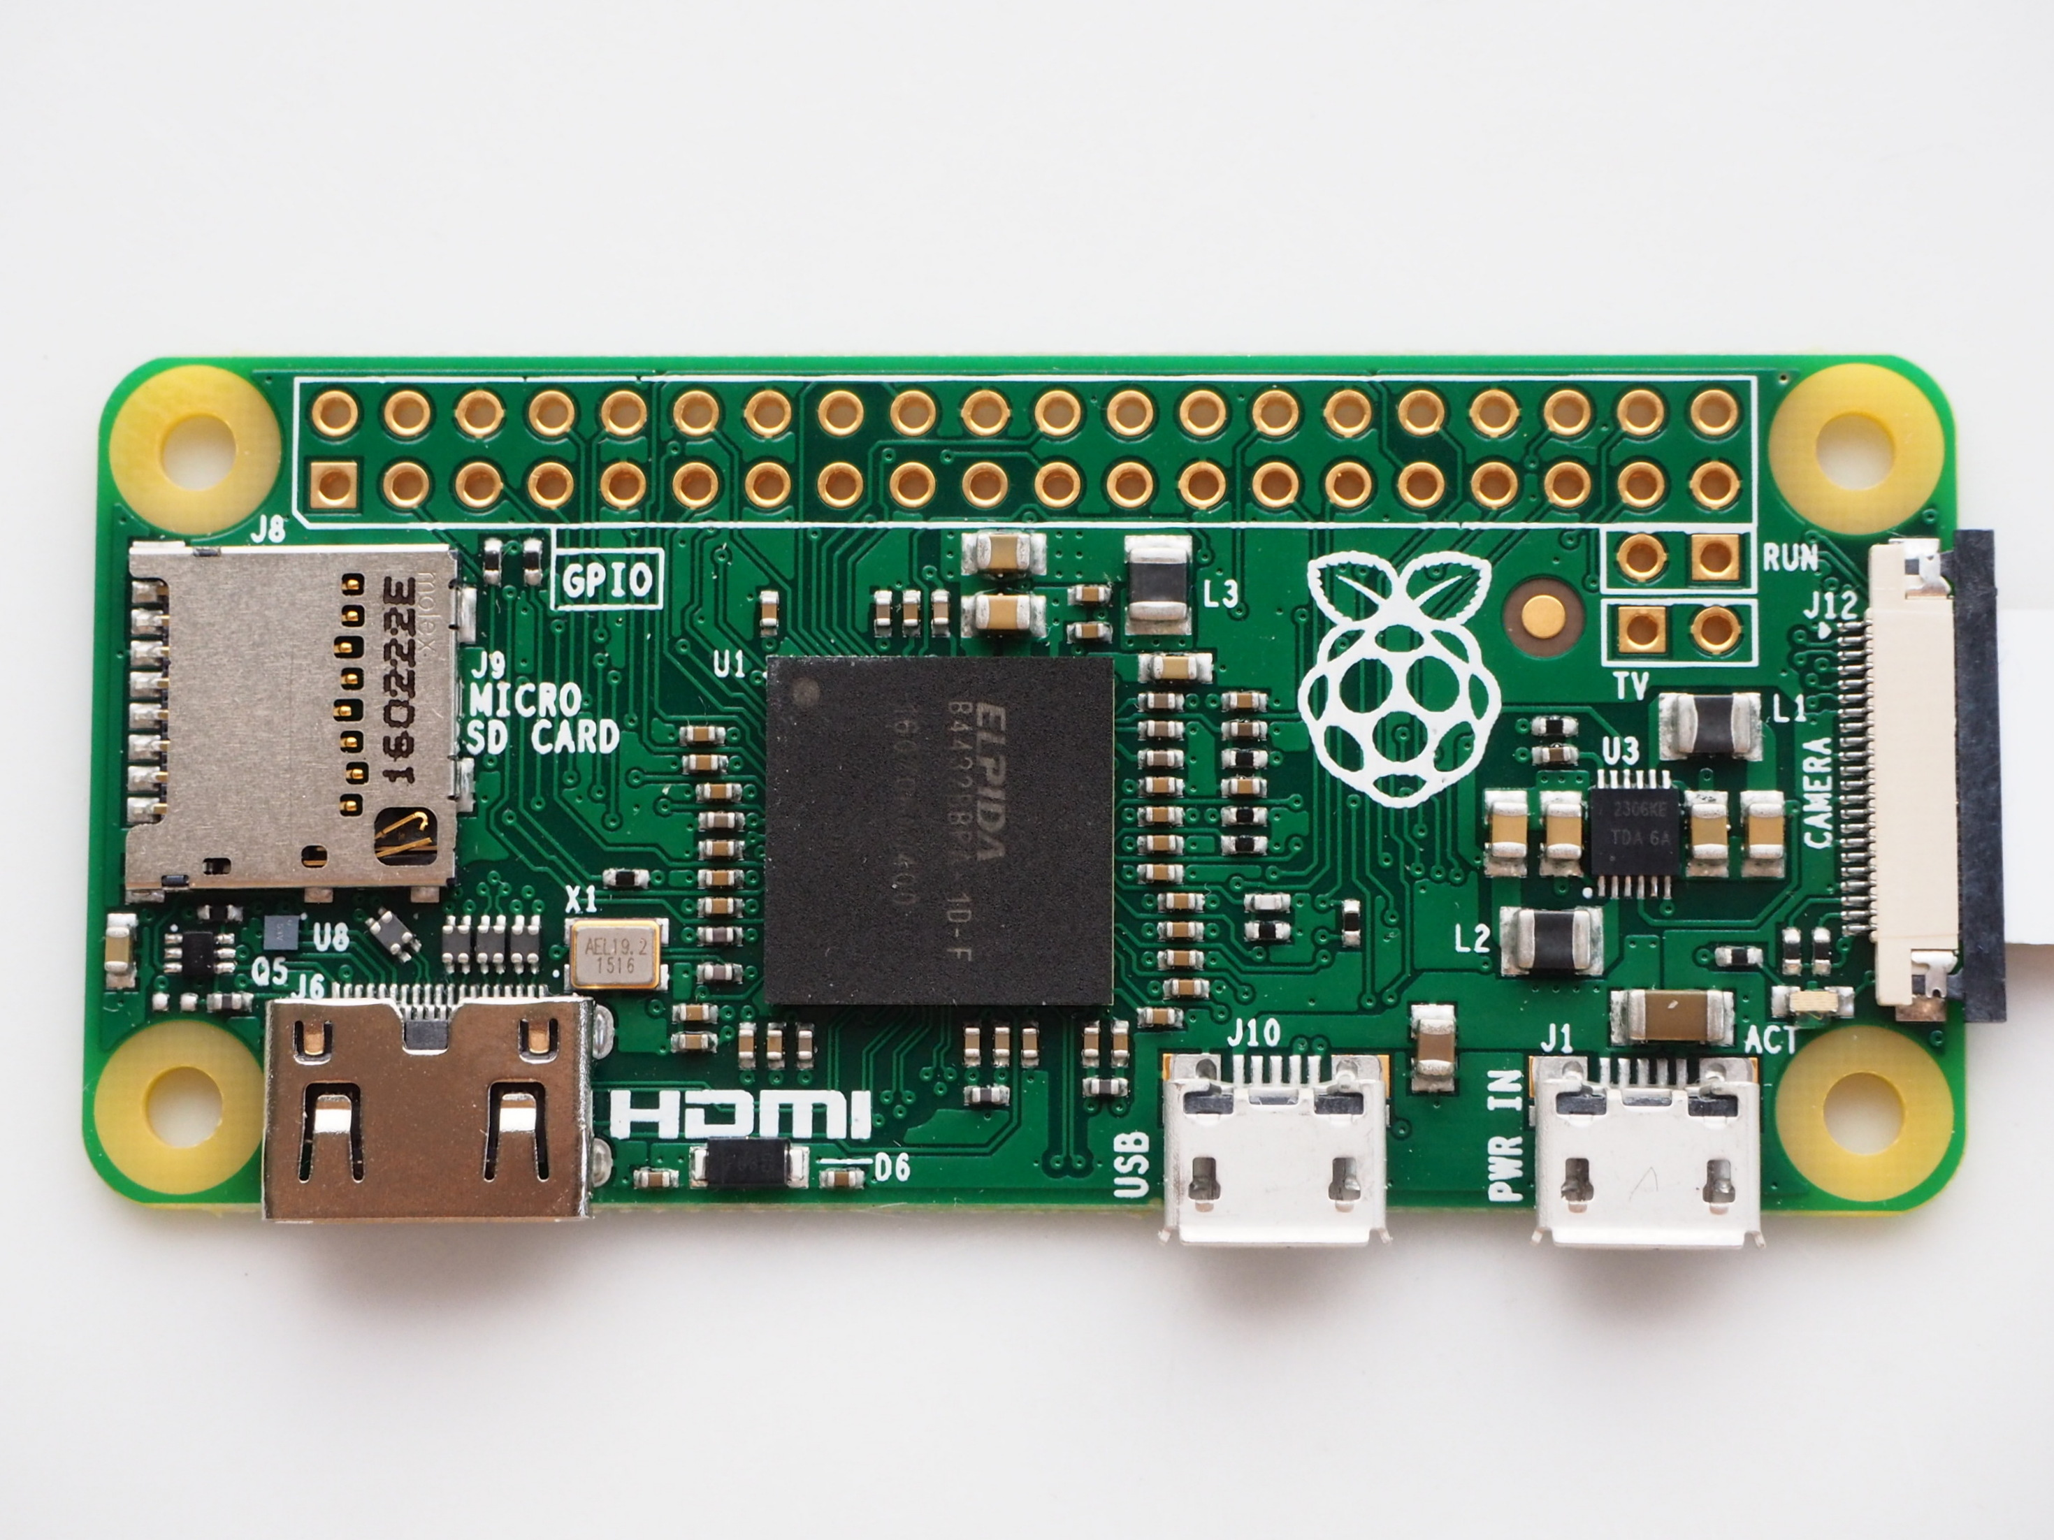
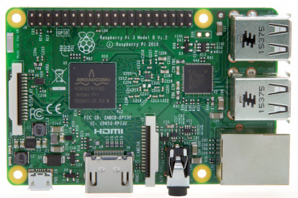
Raspberry Pi Family
Raspberry Pi Timeline

Slide 9
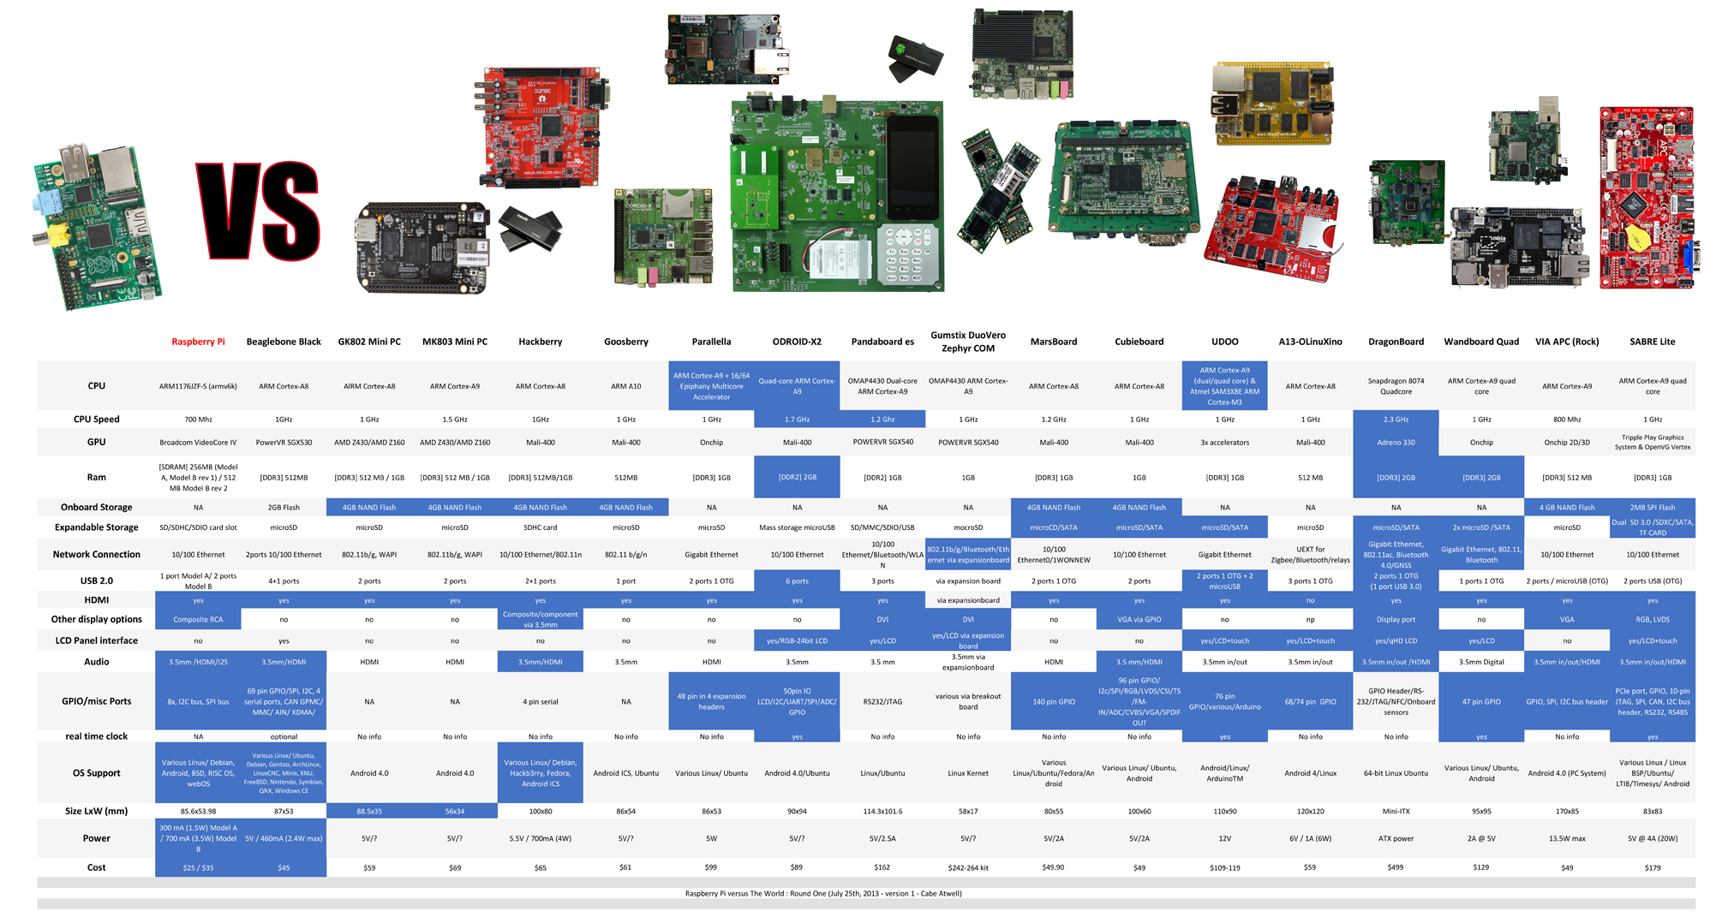
Other Small Computers

Slide 10
Raspberry Pi 3 Specs.
Specifications
SoC: Broadcom BCM2837 Chipset CPU: 4× ARM Cortex-A53, 1.2GHz GPU: Broadcom VideoCore IV RAM: 1GB LPDDR2 (900 MHz) Networking: 10/100 Ethernet, 2.4GHz 802.11n wireless Bluetooth: Bluetooth 4.1 Classic, Bluetooth Low Energy Storage: microSD GPIO: 40-pin header, populated Ports: HDMI, 3.5mm analogue audio-video jack, 4× USB 2.0, Ethernet, Camera Serial Interface (CSI), Display Serial Interface (DSI)

Slide 11
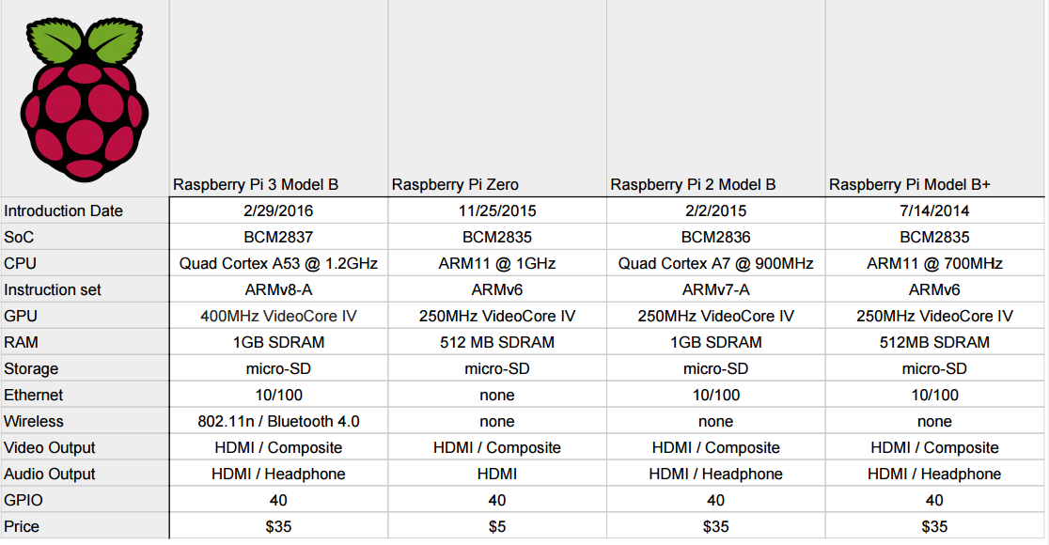
Raspberry Pi Models Comparison

Slide 12
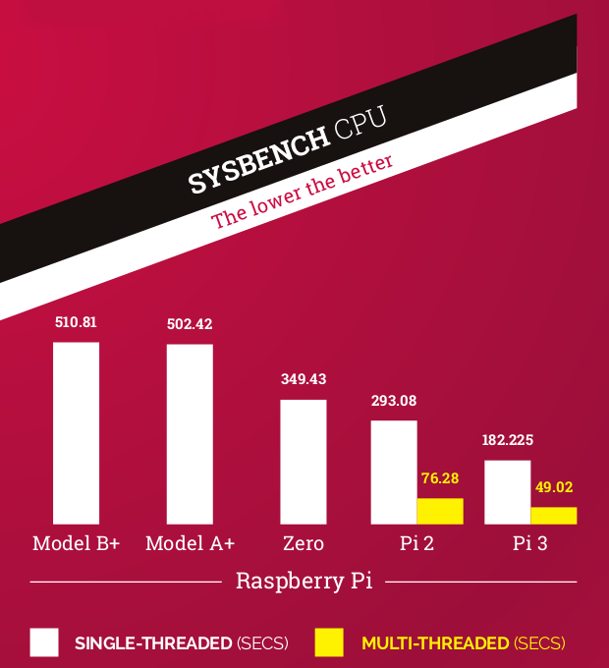
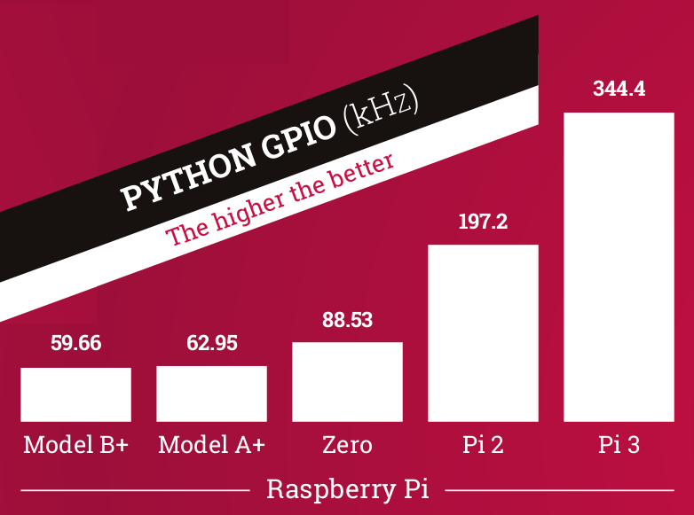
Newer model = Better performance

Slide 13
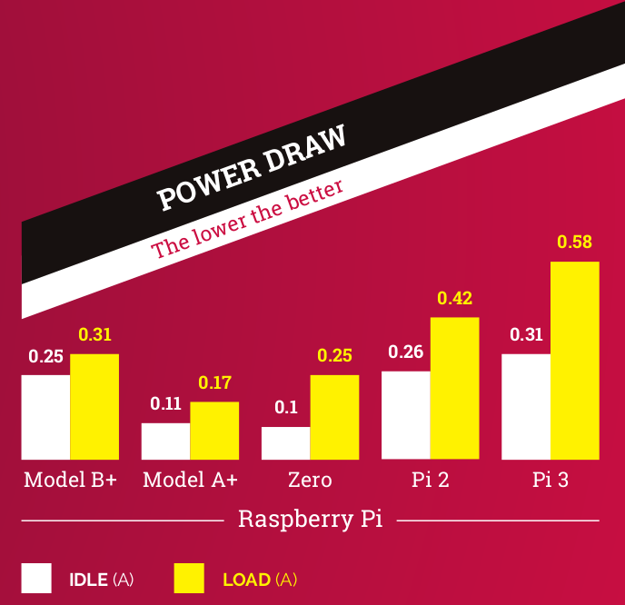
How about power consumption

Slide 14
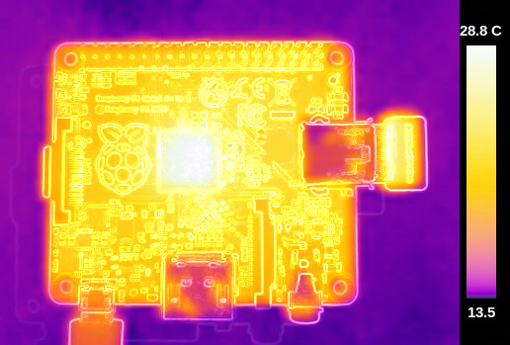
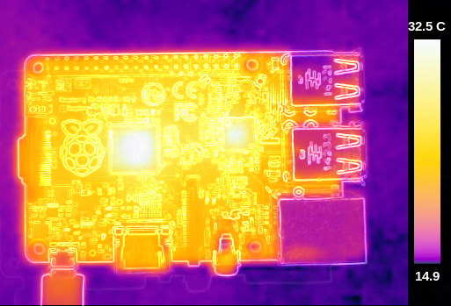
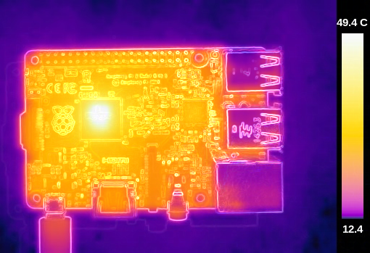
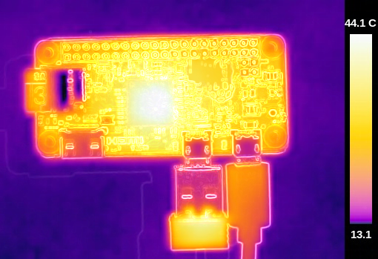
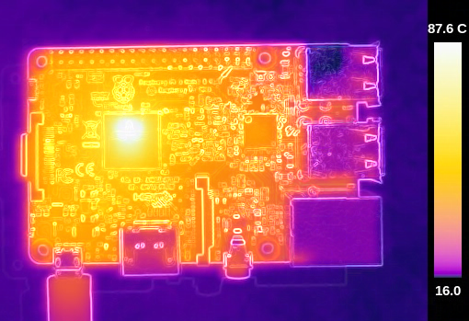
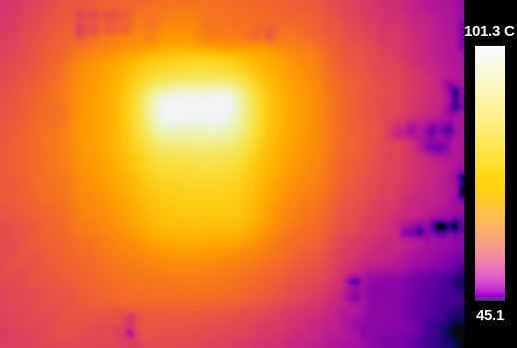
Is it getting hot?
Model A
Model B
Model 2B
Pi Zero
Pi 3 Model B
Pi 3 Model B CPU

Slide 15
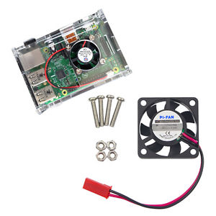
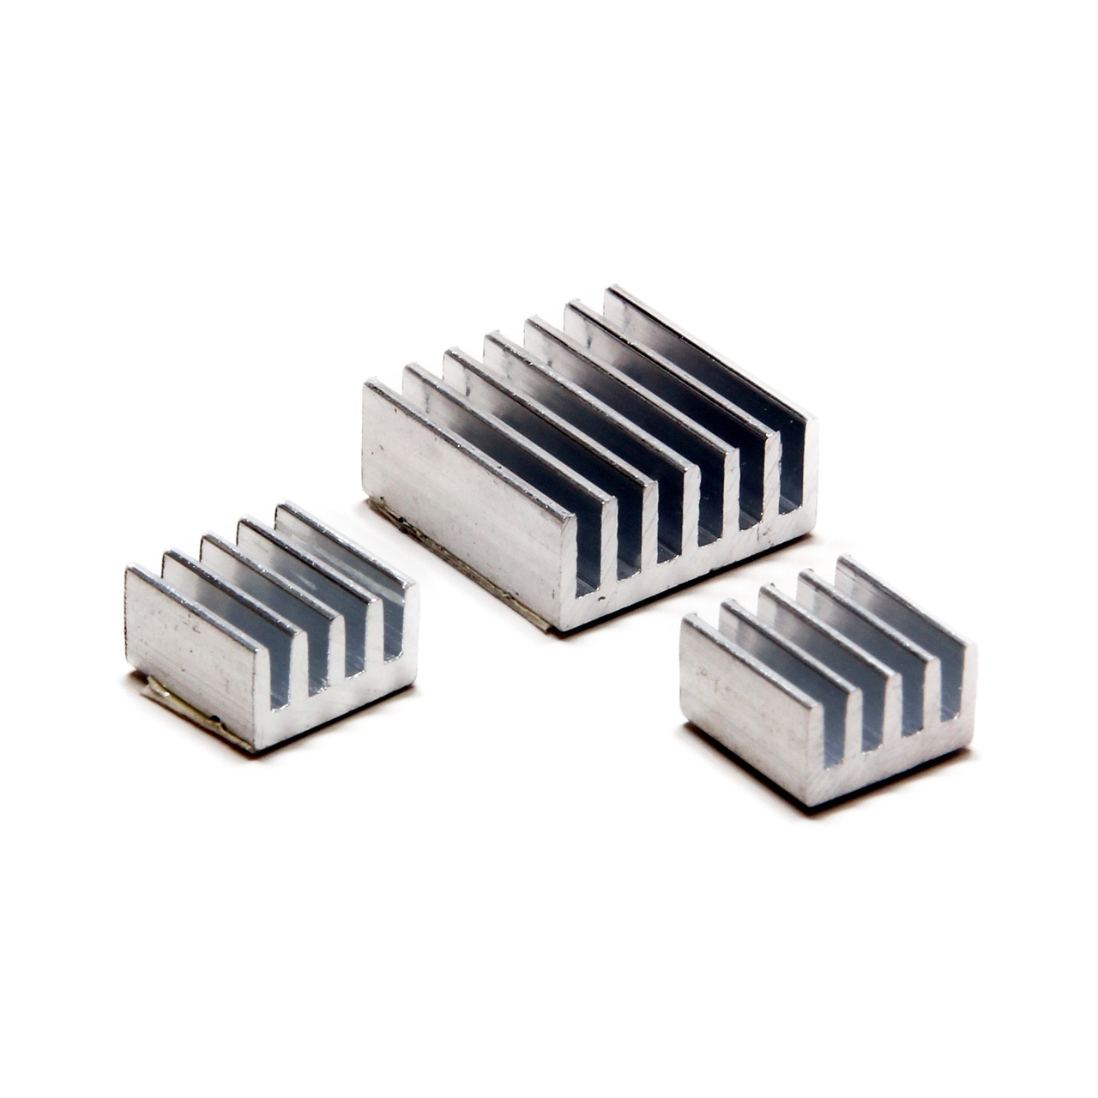
Raspberry Pi Heat Sinks and Cooling Fan
Heat Sink
Cooling Fan

Slide 16
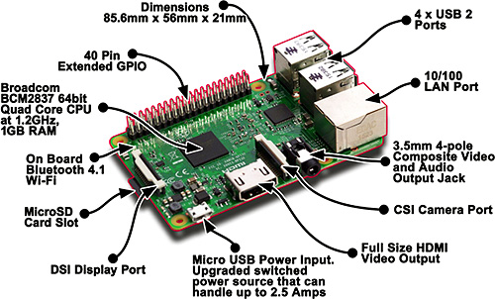
What is on the board?

Slide 17
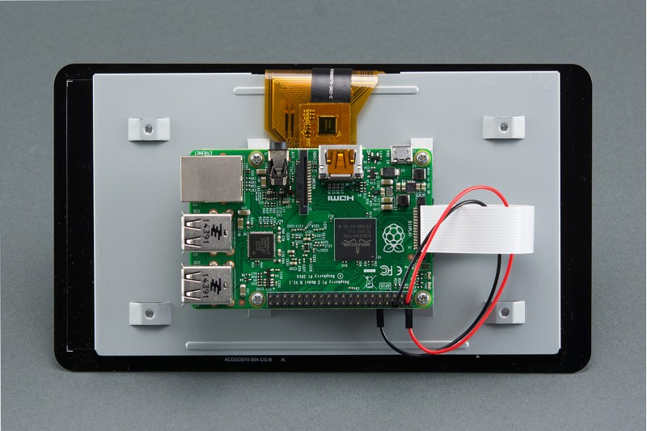
DSI Display Port
DSI stands for Display Serial Interface. According to MIPI, DSI specifies the interface between a host processor and a peripheral such as a display module. It is a high-speed serial interface based on a number of data lanes. The chipset on the board sends the graphics data directly to the display panel trough this port. That allows us to connect color LCD to a Raspberry Pi.
Some of the advantages of DSI:
High bandwidth 1Gbits.
Low operating voltage ( 200mV)
Less noise
Less electromagnetic interface
Lower price
Less power consumption
According to, Raspberry Pi foundation DSI displays are only created and sold for special purposes such as smartphones, tablets, and other mobile devices.

Slide 18
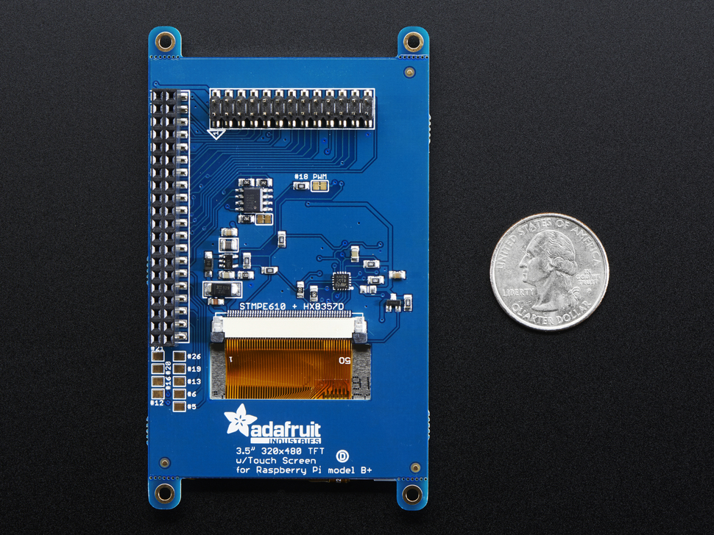
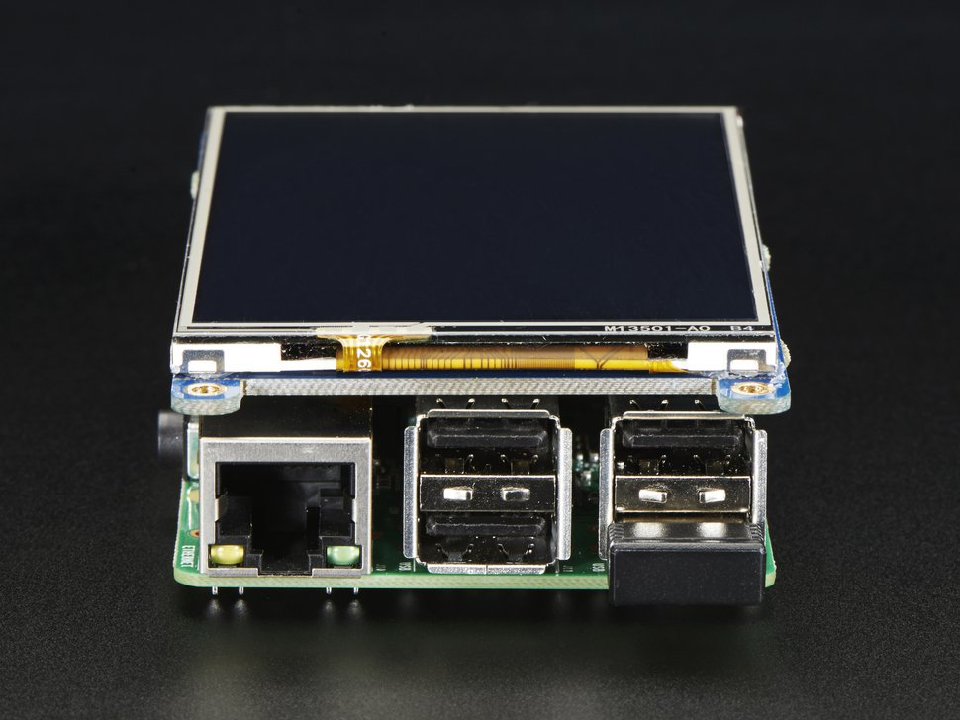
What other display options do we have?
https://www.adafruit.com/product/2097
It is a touch screen TFT display that uses the hardware SPI pins to send the graphics data to the display. That means it uses some of the GPIO pins.
Resolution is reasonable.

Slide 19
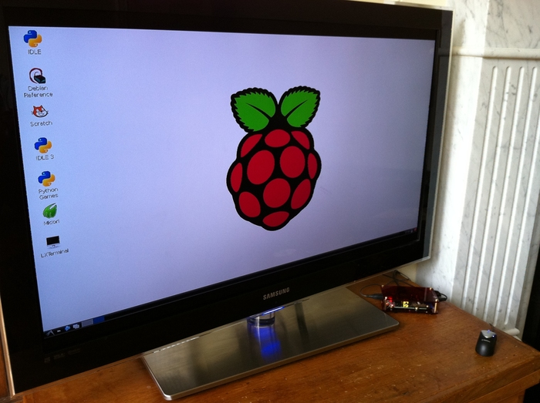
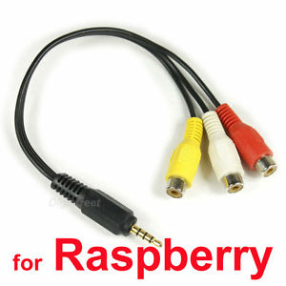
HDMI and Composite Video & Audio
You can use your Raspberry Pi with any display or TV that has a HDMI input.
If you have an ancient display that uses RCA connecter, you can connect your Raspberry Pi to your display with a composite video adaptor.

Slide 20
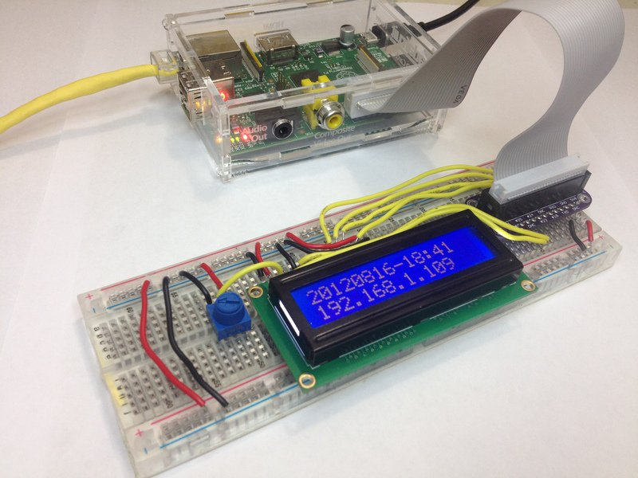
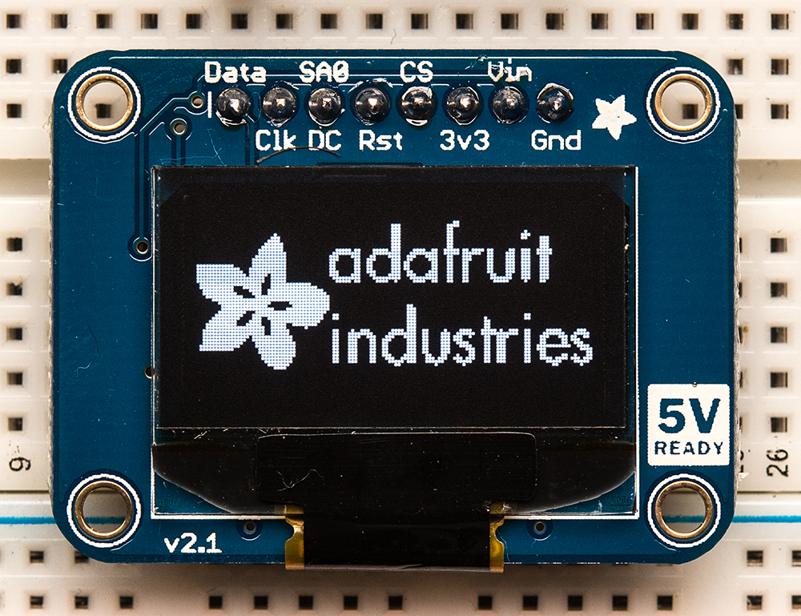
Character cell LCD and OLED Graphic Display
They are easy to use and find, cheap, usually very small. Character cell LCD usually uses the UART serial communication port and Graphic displays uses SPI or I2C communication ports. Therefore, you don’t need a specific cable, connector, or a an adaptor to connect them to your Raspberry Pi. You can use use a bread board and several cables to use them in your project.

Slide 21
What is GPIO?
GPIO stands for General-Purpose Input-Output.
It is a generic set of pins on an integrated circuit or computer board.
They are the physical interface between a computer and outside world.
They can be used as an input or output.
They have no standard purpose. That means every device can have a different types of GPIO pins or their pin layout could be different on each board.
They can be used for serial communication, powering a device, or reading analog or digital data.
You need to read device datasheet before you program GPIO pins.

Slide 22
GPIO on Raspberry Pi
The header provides 5V on Pin 2 and 3.3V on Pin 1.
The 3.3V supply is limited to 50mA.
The 5V supply draws current directly from your microUSB supply so can use whatever is left over after the board has taken its share.
A 1A power supply could supply up to 300mA once the board has drawn 700mA.
Using the GPIO outputs is an easy task. They are on or off. In other words, the signal on a GPIO output pin can be HIGH or LOW. HIGH means 3.3v and LOW means 0v.
Be careful! The most pins are directly connected to the chipset. That means there is no voltage protection on the board. If you do something wrong, you can easily damage your Raspberry Pi.

Slide 23
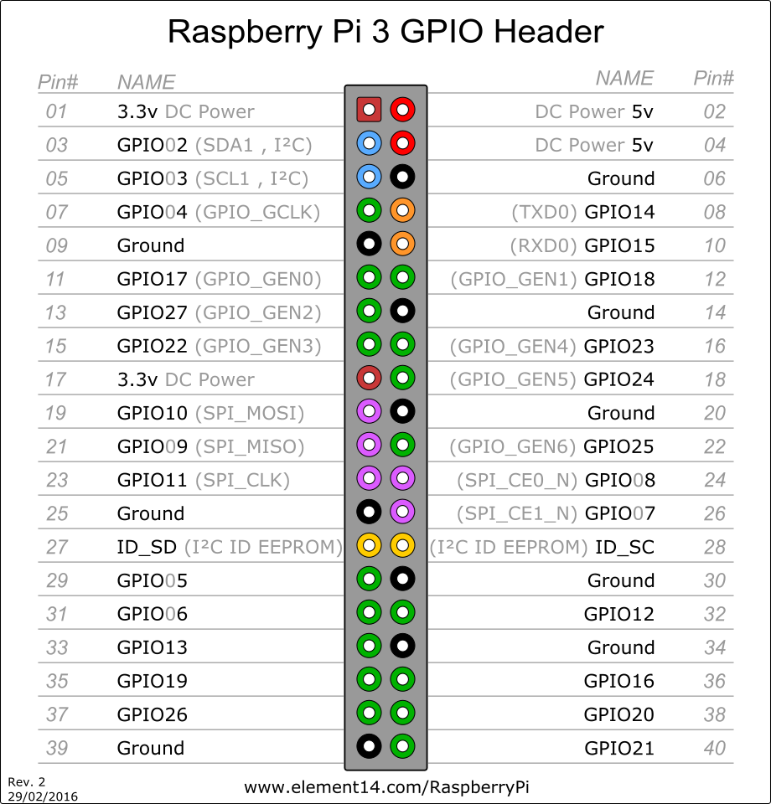
Raspberry Pi GPIO Pinout
24x - GPIO pins
2x - SPI bus
1x - I2C bus
2x - 5V power pins
2x - 3.3V power pins
8x - Ground pins

Slide 24
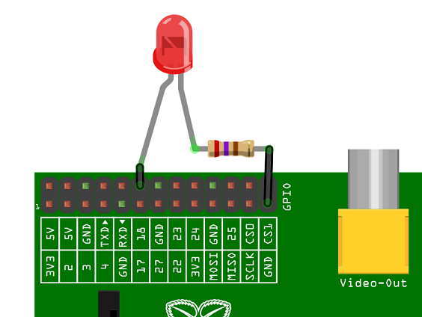
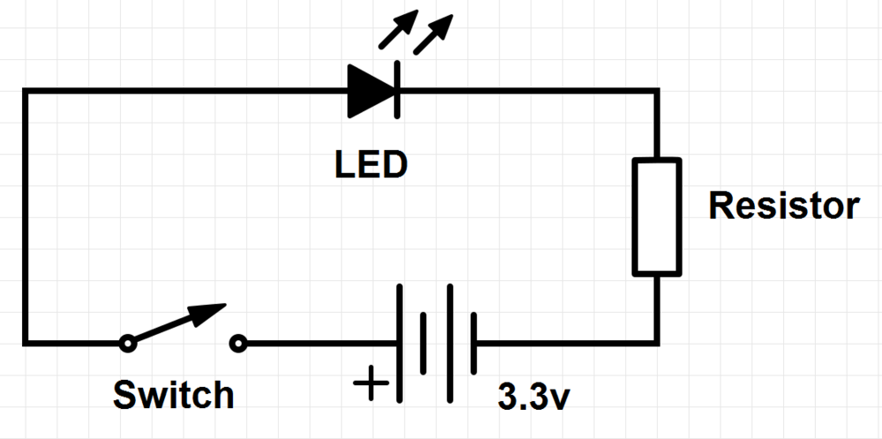
A Simple circuit design that uses the RasPi GPIO Pins.

Slide 25
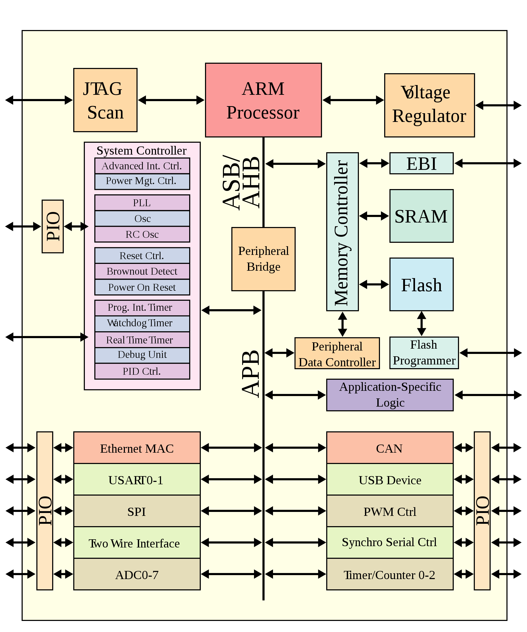
What is SoC?
SoC means System on a Chip.
SoC is an integrated circuit that includes all components of a computer or other electronic system into one single chip.
It may contain PID controller, audio receiver, ADC (Analog Digital Converter), sensors, memory etc.
System-on-a chip technology is used in small, and usually complex electronic devices such as smartphones, tablet computers, single board computers, FPGA boards etc.

Slide 26
What is Arm?
ARM is one of the industry leading suppliers of microprocessor technology. They dominate the market.
ARM stands for Advanced RISC (Reduced Instruction Set Computing) Machine.
ARM develops the architecture of microprocessors and licenses it to other companies.
This means that they don’t really produce microprocessor, but they sell other companies their designs, and these companies build a system around ARM’s architecture. They add maybe some data busses and modules to it.
Broadcom that is used on Raspberry Pi 3 is an ARM based SoC.

Slide 27
What is Flash RAM, SRAM, and Micro SD Card?
RAM stands for random access memory. It is type of a memory that the microprocessor can read from and write to. The data is on the memory as long as the power is on.
Flash RAM = It is a special type of memory. It is just like RAM you can write an read data, but it is not erased when the power is off.
DRAM = A type of RAM that needs refresh cycles to keep the data on it.
SRAM = A type of RAM that doesn’t have refresh cycles.
Micro SD Card = It is type of a removable flash memory that is used for storing data. It is the main storage unit of Raspberry Pi.

Slide 28
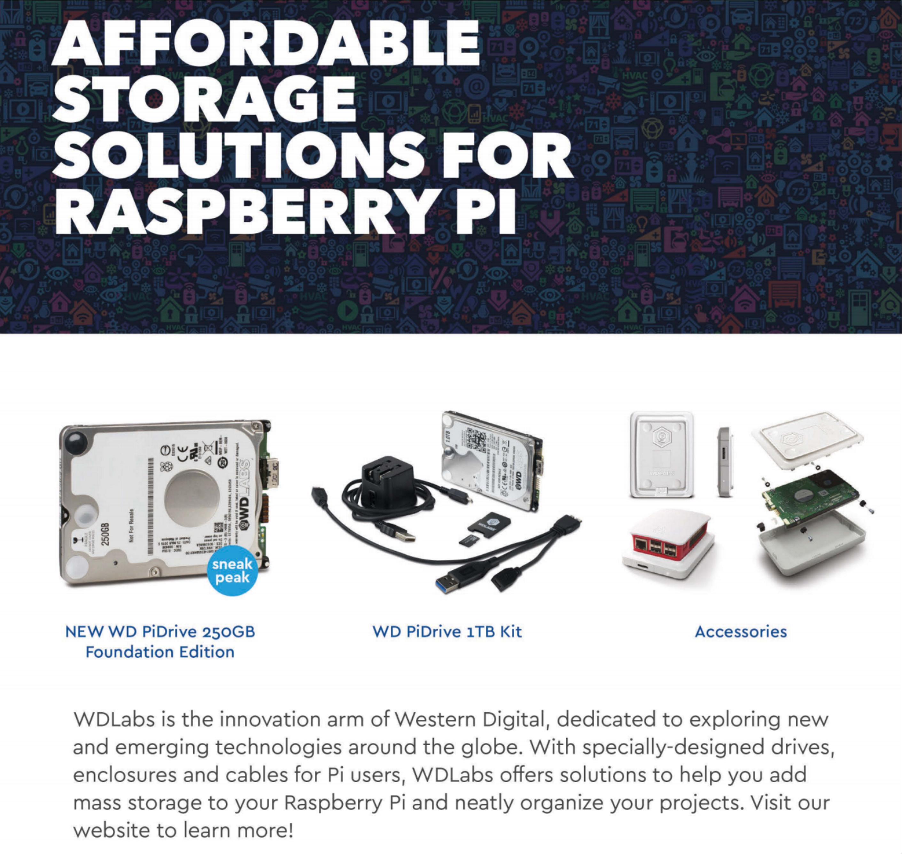
Good news about storage
SD card is one of the things that slows the Raspberry Pi down.
We will be able connect an SDD drive to our Raspberry Pi computers soon!
It will require an adaptor and external power source.
This is great news because in some projects, people really need very high speed and big hard drives.
Hopefully, it is going to be cheap ☺

Slide 29
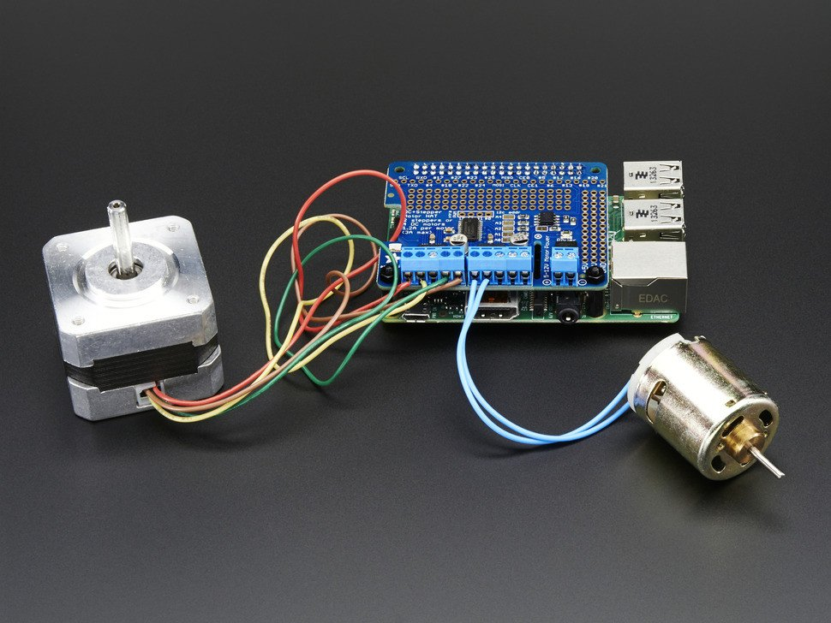
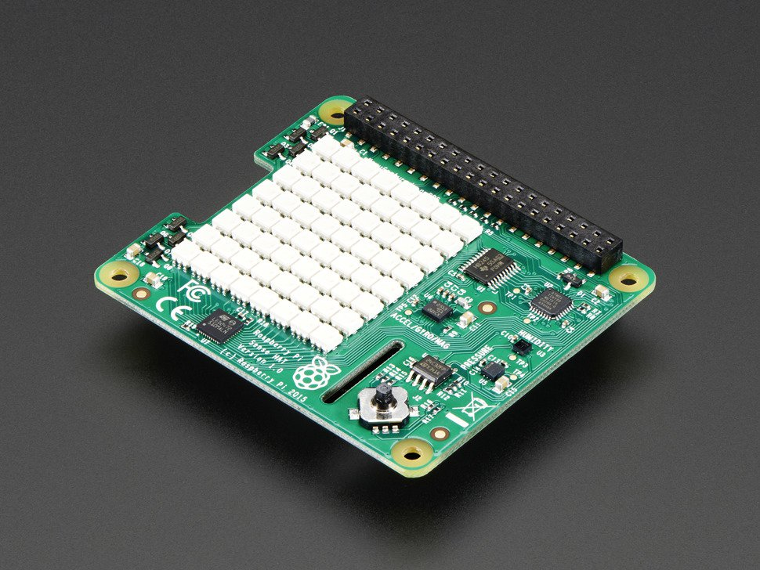
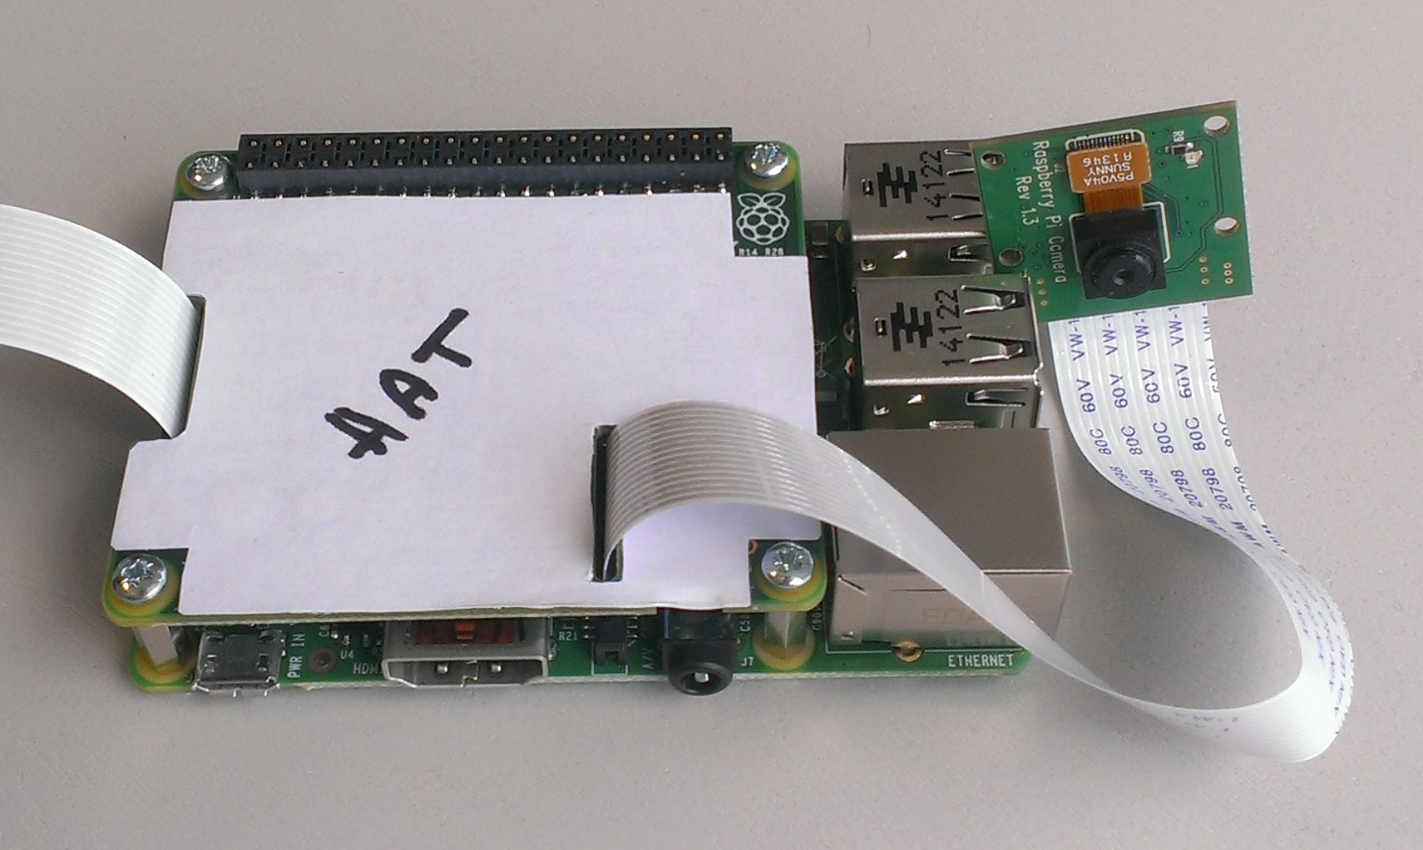
Raspberry Pi hats and devices
Attachable hardware to the Raspberry Pi GPIO connector.
They are used to extend Raspberry Pi’s functionality.
HAT stands for Hardware Attached on Top.
Rapsberry PI HAT specifications are available on their website, so you can build your own Hat for your project.

Slide 30
Raspberry Pi Cam
The module has an 8 megapixel sensor.
The camera can be used in projects that requires high-definition picture an video quality.
It is cheap, small and easy to use.
It supports high definition video formats such as 1080p30, 720p60 and VGA90
It works with all the model.
It uses the CSI Camera Port. This port is directly connected to the chipset. This makes it run very fast.

Slide 31
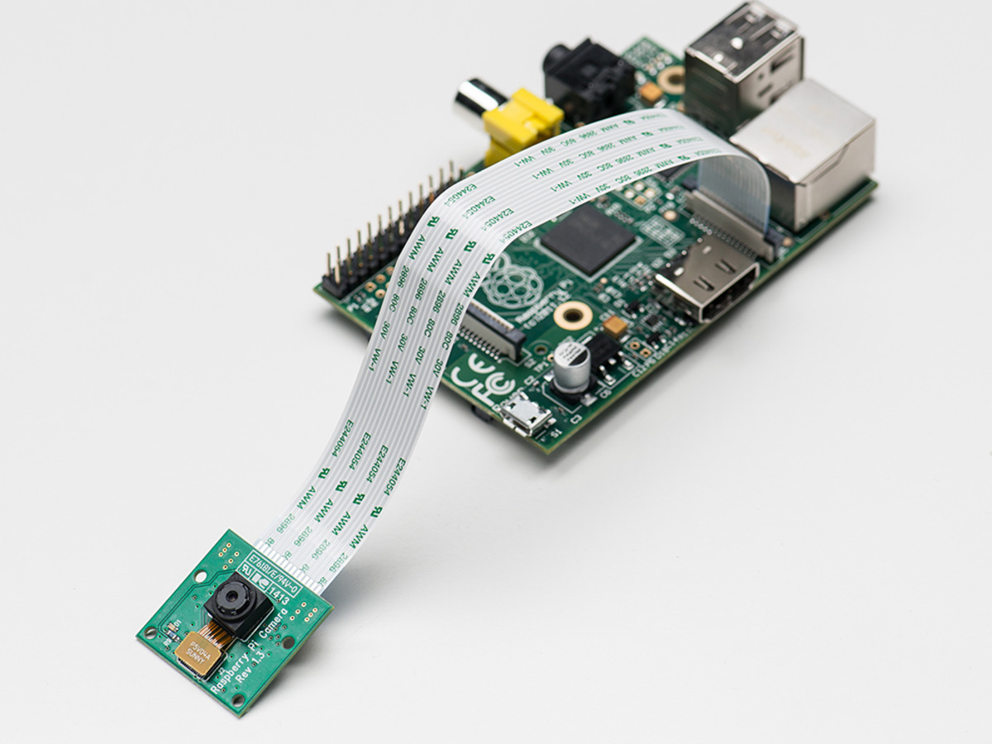
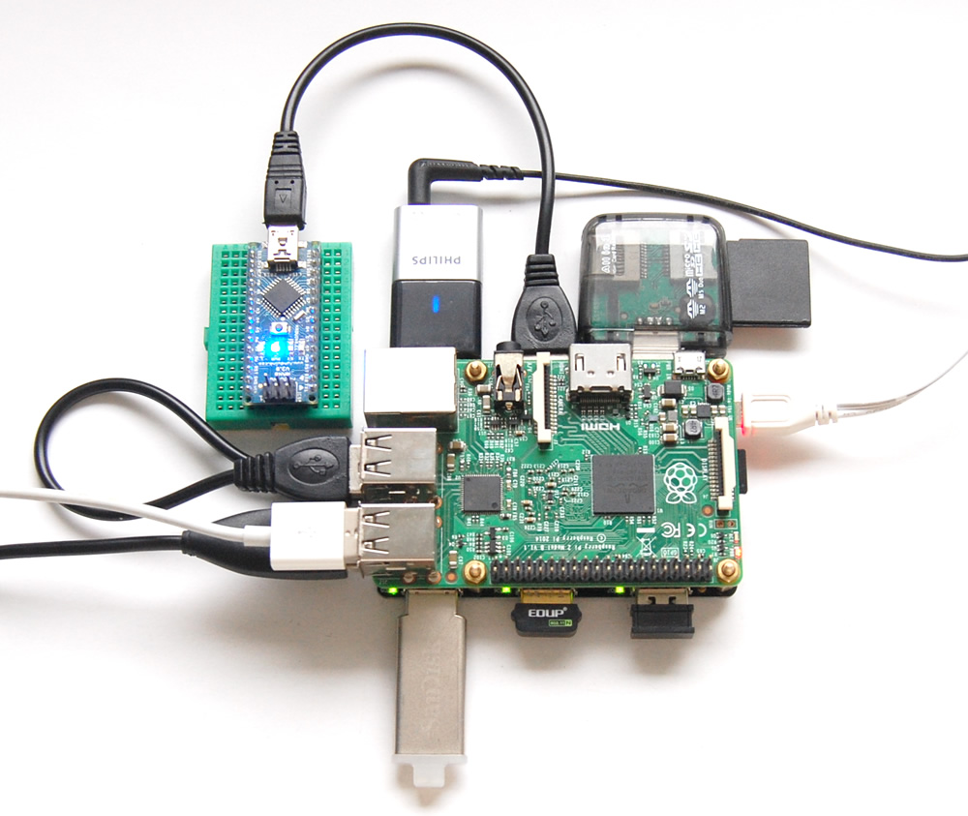
USB Devices
You can connect any USB device to you Raspberry Pi such as USB flash memory, mouse, keyboard, webcam, USB sound card.
The device needs to supported by the operation system that you have on your Raspberry Pi.
Raspberry Pi can power devices from 100 mA to 500 mA.
If you need more power for your USB device you should you a USB hub that has an external power supply.

Slide 32
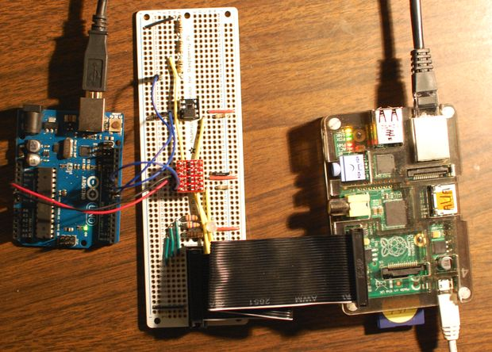
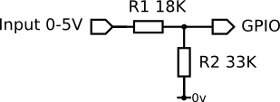



Voltage Divider - 5V <-> 3.3V
There is a problem when connecting a 5V device to the GPIO on a Raspberry Pi. The logic level on Raspberry Pi is 3.3V, so sensing 5V to the GPIO pin may damage the Raspberry Pi.
Therefore, we need to change the logic level from 5V to 3.3V.
In our case voltage divider is used to connect a digital signal from a 5V device to a GPIO pin on the Pi, which requires a 3.3V input level.
Raspberry Pi uses 3.3V logic level to decrease the power consumption.
You can build your own voltage divider or you can buy a voltage divider circuit board.

Slide 33
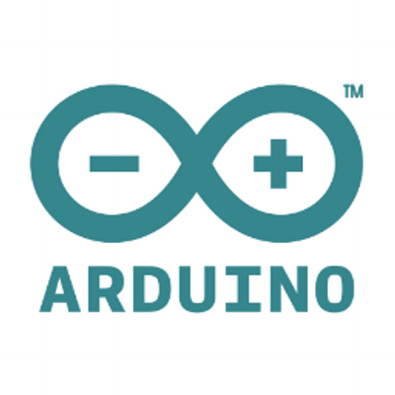
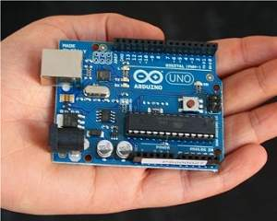
What is Arduino?
Arduino is an open-source electronics platform. It has a microcontroller on it. It also has input and output pins on it.
Arduino consist of both a physical programmable circuit board and a IDE that runs on an computer. IDE is used to write code and upload it to the physical board.
It is very popular and it is supported by a very large community.
Microcontroller is a SoC just like the chipset that is on Raspberry Pi.

Slide 34
Arduino vs Raspberry Pi
Arduino
Slower | Faster
32-bit processor ( Can have more resolution) | 8- bit processor
Address base is bigger | Smaller address base
32K Flash | 4GB Flash
2K SRAM + ADC | 512K SRAM + SD Card
5V Voltage Level – consumes more power | 3.3 Voltage level - consumes less power
Application (IDE) to Microcontroller ( Very Fast) | Runs an operating system ( Layer of software that run on hw)
 | App -> Librarry -> SystemCalls -> Microcontroller
 | Require Memory
 | + Text-based interface, Graphic Interface
 | Multiple Processes
Need to write code to add devices | No need to write any code to use devices
$25 | $35

Slide 35
Is it really an IoT device?
IoT means Internet of Things, and Internet of Things means internetworking devices with some electronics, sensors, actuators, and software.
If you use your Raspberry Pi as a laptop, it is a substitute for your laptop.
However, if you add some electronics to your Raspbeery Pi sensors, motors, displays, microphone, and try to read from and send data to your Raspberry Pi via a network connection, it is a IoT device.

Slide 36
The things you can do with it
https://www.raspberrypi.org/magpi-issues/MagPi50.pdf

Slide 37
What you will need
USB Charger
HDMI Cable
HDMI to VGA Adaptor
Mouse
Keyboard
Micro SD Card (only buy this one) Class 10 - 16 GB Micro SD Card
Monitor

Slide 38
Software
Since it takes a long time to download all these files, you need to download them on your laptop before you come to the lecture next week.
Raspbian Jessie with PIXEL
https://www.raspberrypi.org/downloads/raspbian/
Micro SD Card Formatter
https://www.sdcard.org/downloads/formatter_4/
RUFUS (If you use Linux or Windows)
https://rufus.akeo.ie/
Ubootin (If you use OSX)
https://unetbootin.github.io/
Putty (If you use Windows)
http://www.chiark.greenend.org.uk/~sgtatham/putty/download.html

Slide 39
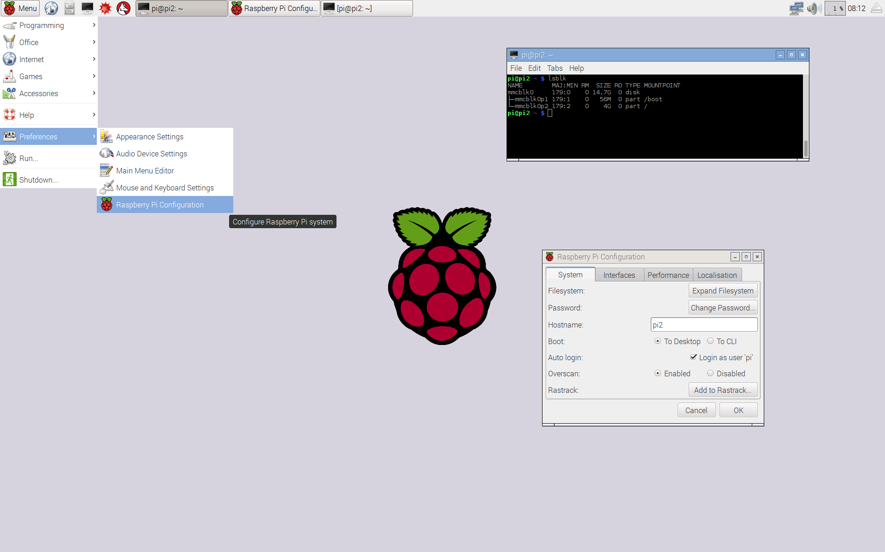
Raspbian Jessie
Raspbian is the supported operating system for Raspberry pi.
It is a free operation system based on Debian that is optimized for the Raspberry Pi hardware.
Verisons are named after the character of the “Toy Story” movie. The previous Raspbian version is named Wheezy.
It is still under active development.
Raspberry Pi foundation doesn’t make this OS. It is not their product.
It comes with pre-install software for education, programming, and general use such as text editor, Python, and Java more.
Its GUI is also very easy to use.

Slide 40
Good sources to learn more about Raspberry Pi.
MagPi Magazine
Raspberry Pi website and blog
Element 14 Forum
Hack a Day website
Adafruit website

Slide 41
Next Week
How to setup your Raspberry Pi
More about Raspbian
Linux commands
SSH
Introduction to Python
Digital Output
Demo : Blink an LED
Digital Input
Demo : Push Button and Switch

Slide 42
Thanks for listening
Any questions?

